Slide 1

Optometry Ensemble
Luis RUBEN MEJIA GARCIA

Slide 2

Concepts applied
WITH FRAMEWORK
Decision tree
Random forest
WITHOUT FRAMEWORK
Gradient descent
Linear regression

Slide 3
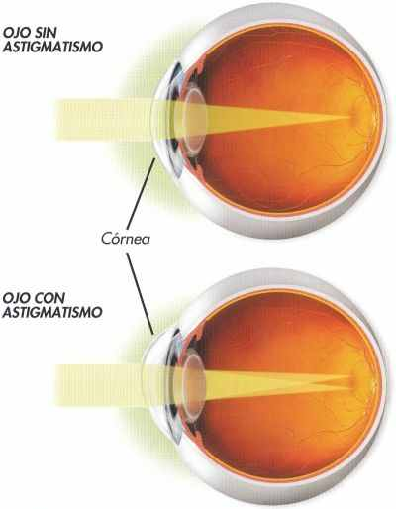
Astigmatism
What´s is?
Is an imperfection in the curvature of the cornea or lens of the eye. Causing distortion on the light that goes to the cornea.
Symptoms
- Blurred vision with near and far objects
- Double vision
- Fatigue
- Headaches

Slide 4
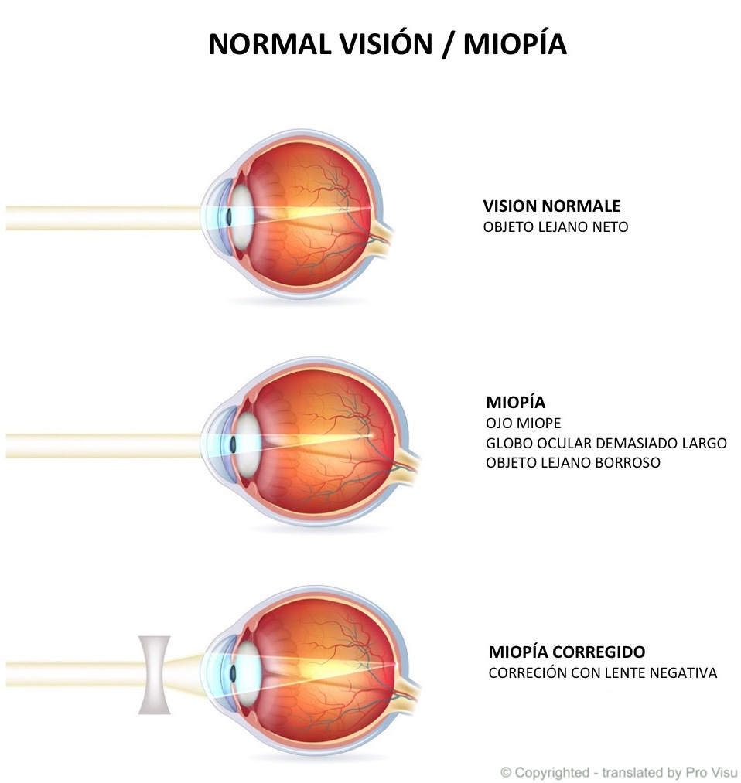
Myopia
What is?
Its when our eyes or eye prevents light from bending properly, cause the light to reflect in front of the cornea, instead of reflecting on the cornea
Symptoms
-Difficulty to see objects placed far away
-Eyestrain

Slide 5
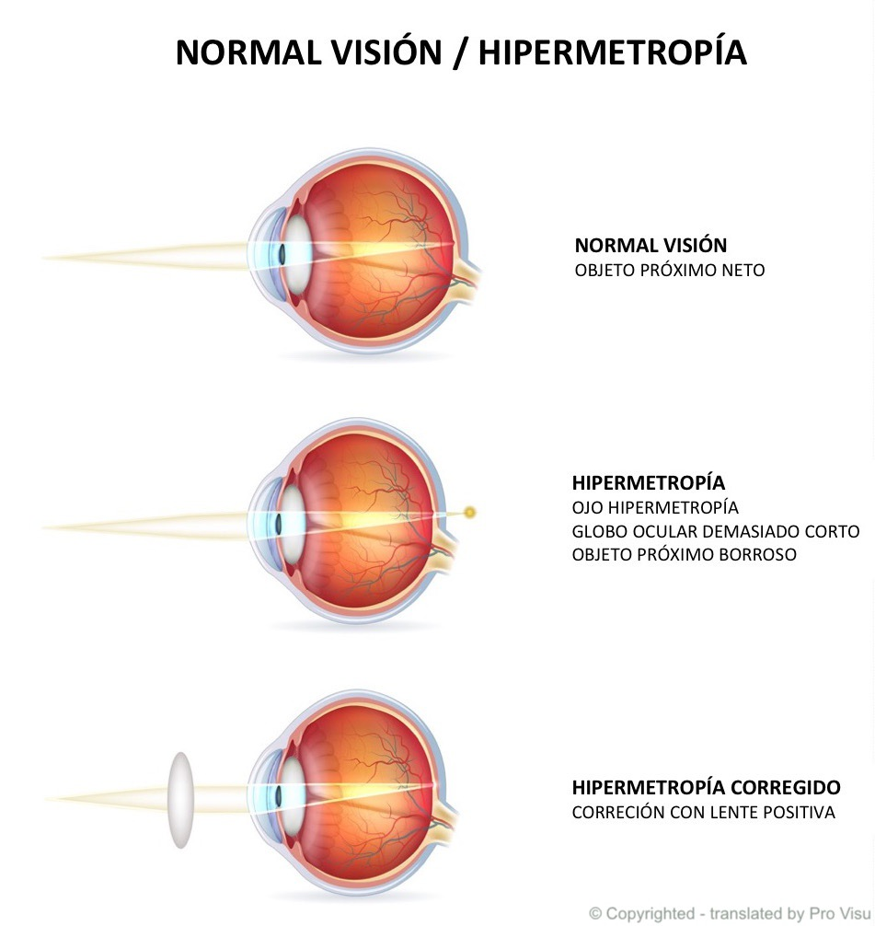
Hyperopia
What is?
Patients with this ametropia are capable of see objects far away but have difficulty to focus objects nearby.
Symptoms
Blurry vision (near objects)
Difficulty reading
Headaches
Squinting

Slide 6
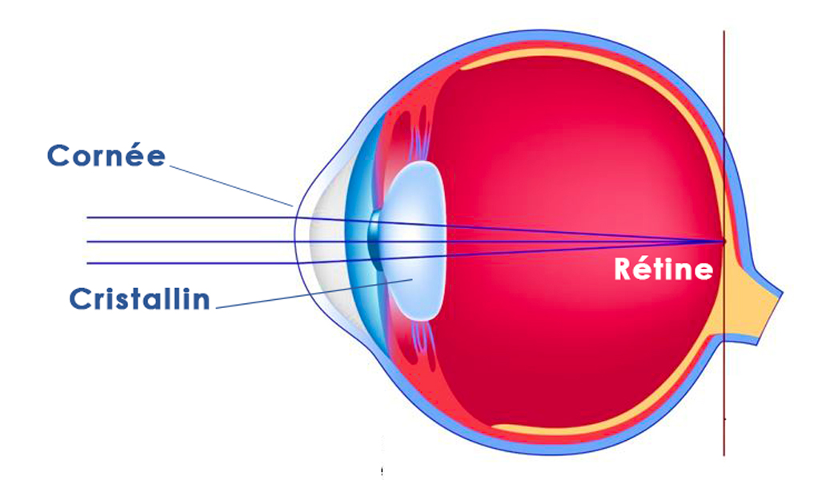
Emmetrope

Slide 7
VIDEO SOLVING A PROBLEM FOR AN EXTERNAL INSTITUTION

Slide 8
Bibliography
Enfermedades de la vista. Miranza. Found it on https://miranza.es/patologias/astigmatismo/
Turbert, David. (September 22, 2022). Nearsightedness: What is myopia?. American Academy of ophthalmology. Found it on https://www.aao.org/eye-health/diseases/myopia-nearsightedness
Farsightedness. Cleveland Clinic. Found it on https://my.clevelandclinic.org/health/diseases/8580-farsightedness
Mendez. Avilio. Astigmatismo. Ciencias médicas. Found it on https://blog.ciencias-medicas.com/archives/940
Team pro visu. (March 10, 2020). Hipermetropía. Pro visu. Found it on https://www.provisu.ch/es/enfermedades-mas-frecuentes/hipermetropia.html

